Slide 1

DSA0202-COMPUTER VISION WITH OPENCV
Edge Vision Guard: Real-Time Safety & Defect Analytics System
By:
Guided by:
Rakina S (192324289)
Harisha S (192324300)
Anipakala Mahesh (192424139)
Dr M Mayuranathan (Professor)
Notes:
1
1

Slide 2
ABSTRACT
The Edge Vision Guard system is designed to analyze real-time camera/video data for detecting safety violations and product defects. The system integrates image preprocessing, computer vision, defect detection, safety monitoring, analytics, and visual dashboards to provide meaningful real-time insights.
Purpose of the Project:
To preprocess and analyze real-time vision data.
To detect safety violations and defects automatically.
To classify detected defects and safety conditions.
To visualize detection results using charts and dashboards.

Slide 3

INTRODUCTION
Modern industrial and workplace environments generate large amounts of visual data through surveillance cameras and inspection systems. Manually monitoring these video streams can make it difficult to identify safety violations and product defects quickly.
Importance of the Project :
Helps identify safety violations in real time.
Detects defective products automatically.
Reduces dependency on continuous manual inspection.
Provides visual analytics of detected defects and safety events.
Supports faster and data-driven decision-making.

Slide 4
PROBLEM STATEMENT
Continuous monitoring of industrial environments and products through cameras is challenging because large amounts of visual data need to be processed in real time. Manual inspection may result in delayed detection of safety violations and product defects.
The lack of a unified system for real-time safety monitoring, defect detection, and visual analytics makes it difficult to identify problems quickly.
Therefore, there is a need for an intelligent vision-based system that can analyze camera input, detect safety and quality issues, and present the results through dashboards and visualizations.

Slide 5
EXSISTING VS PROPOSED SYSTEM
EXISTING SYSTEM | PROPOSED SYSTEM
Safety and defect inspection is mainly manual. | Provides automated vision-based detection.
Continuous monitoring requires human attention. | Provides real-time automated monitoring.
Defects are difficult to identify quickly. | Detects and classifies defects automatically.
Safety events may be recorded separately. | Combines safety and defect analytics in one system.
Limited visual analysis of inspection data. | Provides charts, graphs, and dashboard KPIs.

Slide 6

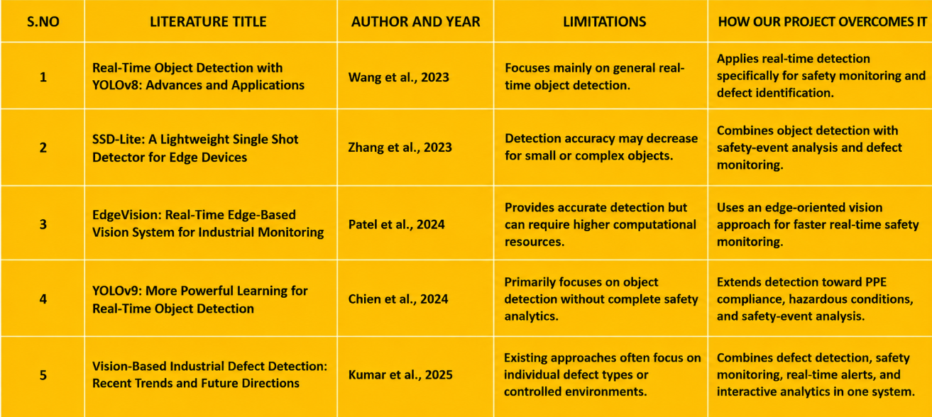
LITERATURE REVIEW

Slide 7
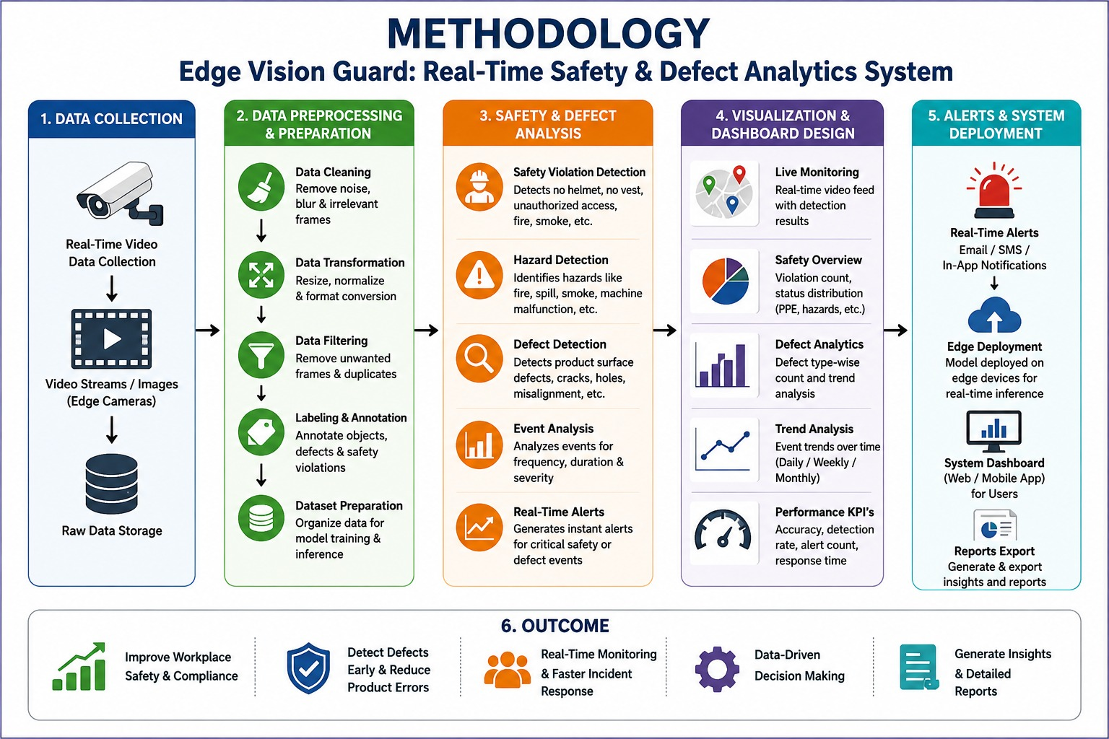

Slide 8
MODULES
Image/Video Preprocessing & Object Detection Preprocesses visual data and detects objects.
Safety & Defect Detection Detects safety violations and product defects.
Real-Time Analytics & Visualization Analyzes results and displays them using dashboards and charts.

Slide 9
Module 1: IMAGE/VIDEO DATA PREPROCESSING & OBJECT DETECTION
Import camera/video/image data.
Preprocess frames for analysis.
Remove noise and improve image quality.
Detect relevant objects in the frame.
Extract important visual features.
Prepare the data for safety and defect analysis.

Slide 10
Module 2: SAFETY VIOLATION
& DEFECT DETECTION
Detect safety-related violations.
Identify defective or abnormal objects.
Classify detected defects.
Analyze object conditions from video frames.
Count safety events and detected defects.
Generate detection results for further analysis.

Slide 11
Module 3: REAL-TIME ANALYTICS
& VISUALIZATION
Display real-time detection results.
Calculate defect and safety-event counts.
Compare different defect categories.
Analyze safety trends over time.
Generate charts and dashboard KPIs.
Present alerts and analytics in an easy-to-understand format.

Slide 12
CONCLUSION
The proposed system provides a unified platform for real-time safety monitoring and defect analytics.
Visual data is preprocessed, analyzed, and detected to identify safety violations and product defects.
Safety and defect analysis provides insights into detected issues and their categories.
Real-time analytics helps monitor safety events and defect trends efficiently.
Charts, graphs, and dashboards make complex detection results easier to understand and compare.
Overall, the system supports faster monitoring, reduced manual effort, and data-driven decision-making.

Slide 13
REFERENCES
OpenCV Documentation – Computer Vision and Image Processing.
Python OpenCV – Image and Video Processing – Used for preprocessing and object detection.
Kaggle – Computer Vision and Defect Detection Datasets – Used for visual data analysis and model development.
YOLO Documentation – Real-Time Object Detection – Used for object detection and safety monitoring.
Python Pandas & Matplotlib Documentation – Used for data analysis and visualization.
Computer Vision Research – Studies on real-time safety monitoring and automated defect detection.

